Slide 1
COM1025: Web and
Database Systems
Module Introduction, Web, URL HTML, Encoding
(Slides credited to Dr. Manos Panaousis)
Joe Appleton
Week 7

Slide 2
A Question To Start
Why is this course teaching both Databases and Web ?

Slide 3
A Question To Start
Why is this course teaching both Databases and Web ?
Almost everyone will interact with Databases everyday, several times a day
Very few people know how to write SQL Queries
We need to provide some interface over the database to allow the right data to be extracted without the need to know SQL
Web applications are one of the most commonly used ways to interact with data in a Database

Slide 4
Structure for Weeks 7 - 10
 | LECTURES
WEEK 7 | An Internet Primer
WEEK 8 | Networking , HTML forms , HTTP, COOKIES & Styles
WEEK 9 | Templating, Forms, GDPR, Routing
WEEK 10 | Tying everything together - The three-tier architecture

Slide 5
A quick question:
PollEv.com​/joeappleton501

Slide 6
Introduction

Slide 7
Today’s outline
About me
Module learning outcomes
Module general information
Module content
Introduction to internet systems
Web, URL
Front-end
HTML
Encoding

Slide 8
About Me
10-years start up and industry experience.
8-years' experience as an academic
Research interests are software engineering in the context of learning in HE.

Slide 9
Learning outcomes for this Section
On successful completion of this module, you will be able to:
Understand how the World Wide Web works and how it relates to the wider context of the Internet.
Understand basic concepts of computer networking.
Demonstrate an understanding of key Web front-end (publishing) technologies and their relationships: HTML, CSS,Node.js, XML, JSON.
Build static and simple dynamic web pages.

Slide 10





Some of the technologies we’ll be using
Client
C
Server

Slide 11
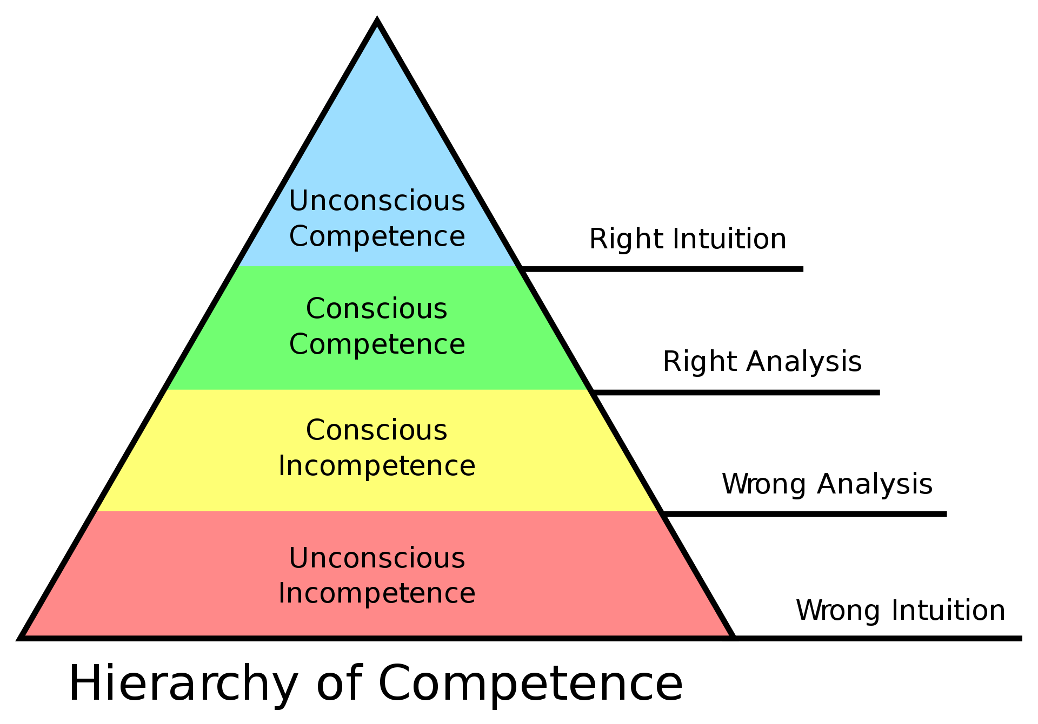
Where are we aiming?

Slide 12
Module follow-ups
COM1025 was designed to be an entry-level module
Cover many topics
JavaScript, CSS
More advanced materials are available for year-2 and/or year-3
COM2025 Web Application Development
…
JavaScript (jQuery)
CSS (LESS)
…
COM3014 Advanced Challenges in Web Technologies
…
Rich Client Web Applications
JavaScript
…

Slide 13
The World Wide Web

Slide 14



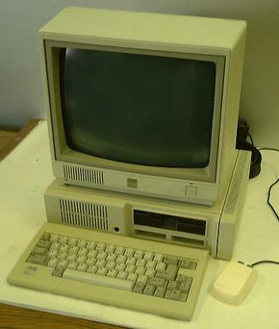
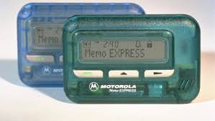
A Trip to the 80s

Slide 15

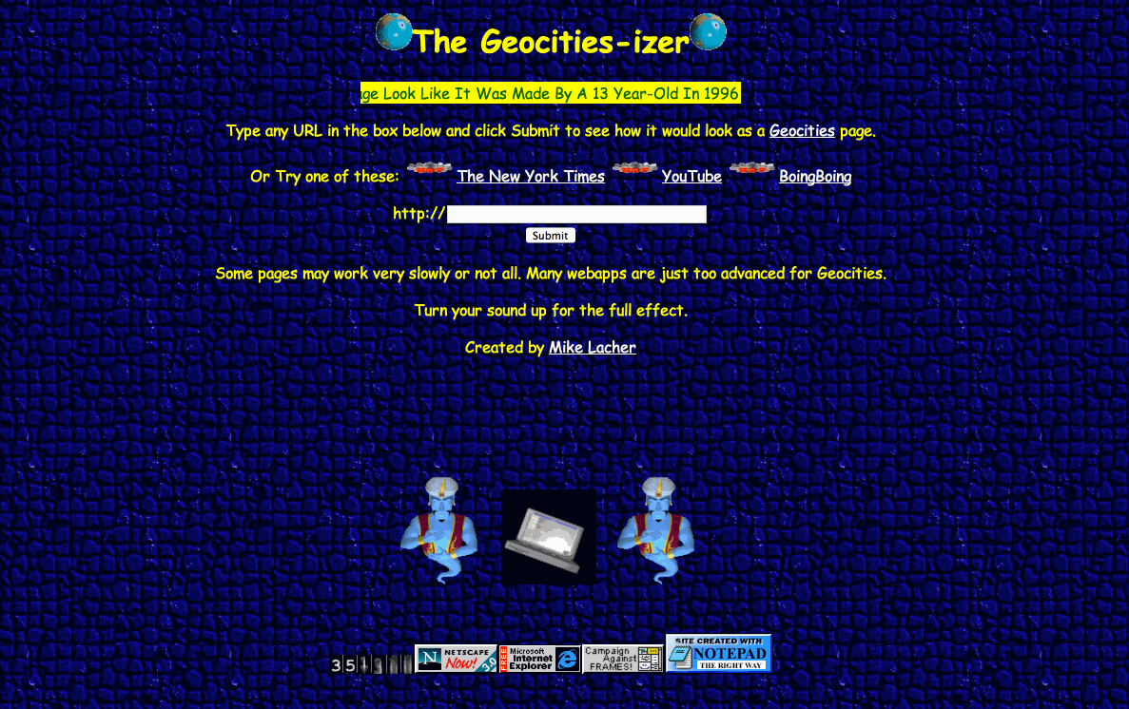
An early timeline of the web
1989: Tim Berners-Lee proposed a hypertext system that would sit on top of the internet.
The system consisted of of the following primary technologies:
A Universal Resource Locator (URL) to identify resources
Hyper Text Markup Language (HTML) to represent HTML documents
A Hyper Text server implementing HTTP
1993: The proposal of an IMG tag and the Mosaic Browser
1994: Yahoo! is created by Stanford University Graduates
GeoCities Created
1995: Amazon and Ebay are created
Notes:
CERN is a wonderful organisation. It involves several thousand people, many of them very creative, all working toward common goals. Although they are nominally organised into a hierarchical management structure,this does not constrain the way people will communicate, and share information, equipment and software across groups.
The actual observed working structure of the organisation is a multiply connected "web" whose interconnections evolve with time. In this environment, a new person arriving, or someone taking on a new task, is normally given a few hints as to who would be useful people to talk to. Information about what facilities exist and how to find out about them travels in the corridor gossip and occasional newsletters, and the details about what is required to be done spread in a similar way. All things considered, the result is remarkably successful, despite occasional misunderstandings and duplicated effort.

Slide 16


What is HTML?
HTML (HyperText Markup Language)
Describes the content and structure of a web page; not a programming language.
Made up of building blocks called elements.
HTML was invented, in 1989, by Tim Berners- Lee (Prof Univ. of Oxford)
Standards are maintained and developed by the World Wide Web Consortium (W3C).
Notes:
CERN is a wonderful organisation. It involves several thousand people, many of them very creative, all working toward common goals. Although they are nominally organised into a hierarchical management structure,this does not constrain the way people will communicate, and share information, equipment and software across groups.
The actual observed working structure of the organisation is a multiply connected "web" whose interconnections evolve with time. In this environment, a new person arriving, or someone taking on a new task, is normally given a few hints as to who would be useful people to talk to. Information about what facilities exist and how to find out about them travels in the corridor gossip and occasional newsletters, and the details about what is required to be done spread in a similar way. All things considered, the result is remarkably successful, despite occasional misunderstandings and duplicated effort.

Slide 17



Client Server
Local
Remote
Client
Server
Client
DB
…..
Client

Slide 18
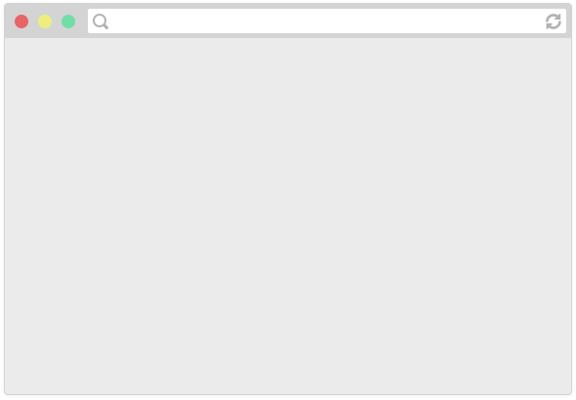
How do web pages work?
Browsers are applications that can display web pages,
e.g. Chrome, Firefox, Safari, Internet Explorer, Edge, etc.

Slide 19
Hypertext documents
Hypertext documents are more commonly known as web pages.
Hypertext documents may link to hypermedia documents, i.e., non-hypertext documents (e.g. an image, a video, a textual file without any special structure).
A web page or a hypermedia document normally resides on a remote computer (called a web server) over the Internet so they can be accessed by people from anywhere in the world.
Each web page or hypermedia document has a web address, or more formally a URL (Uniform Resource Locator) which mainly tells where it is.

Slide 20

How do web pages work?
Web pages are written in a markup language called HTML
Browsers display a web page by reading and interpreting its HTML

Slide 21
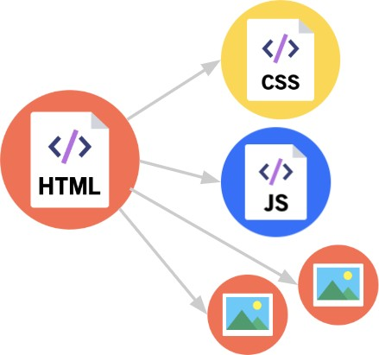
How do web pages work?
The HTML file may link to other resources, like images, videos, as well as JavaScript and CSS (stylesheet) files, which the browser then also loads.

Slide 22
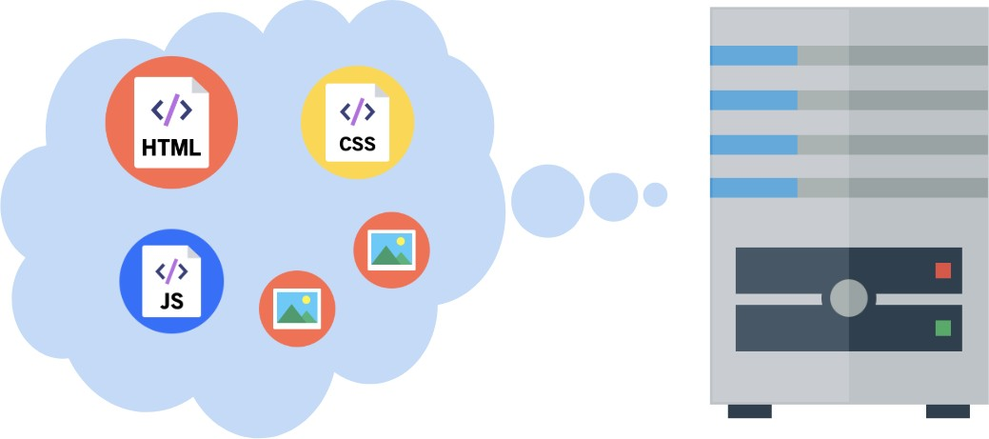
How do web pages work?
A web server is a program running on a computer that delivers web pages in response to requests.
It either has stored or generates the web page returned.

Slide 23
How do web pages work?
1. You type in a URL, which is the address of the HTML file on
the internet.
www.surrey.ac.uk

Slide 24
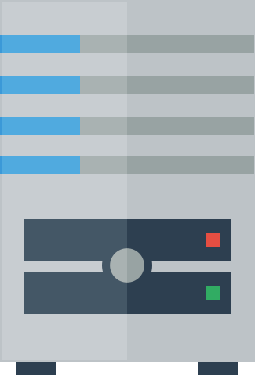
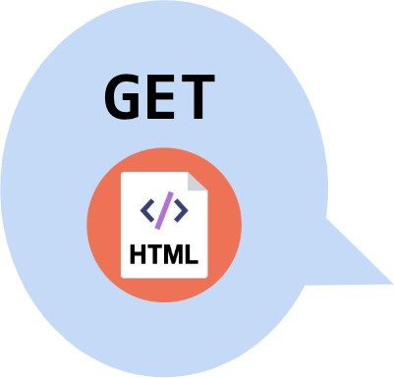
How do web pages work?
2. The browser asks the web server that hosts the document to send that HTML document.

Slide 25
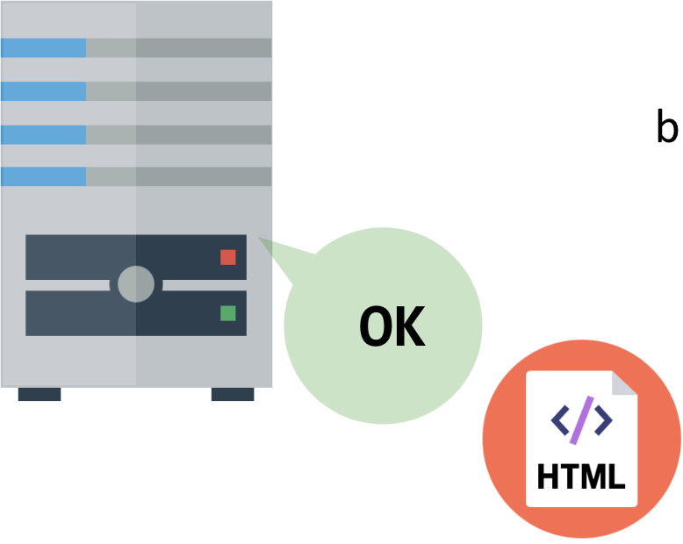
3. The web server responds to the browser with the HTML file that was requested.

Slide 26
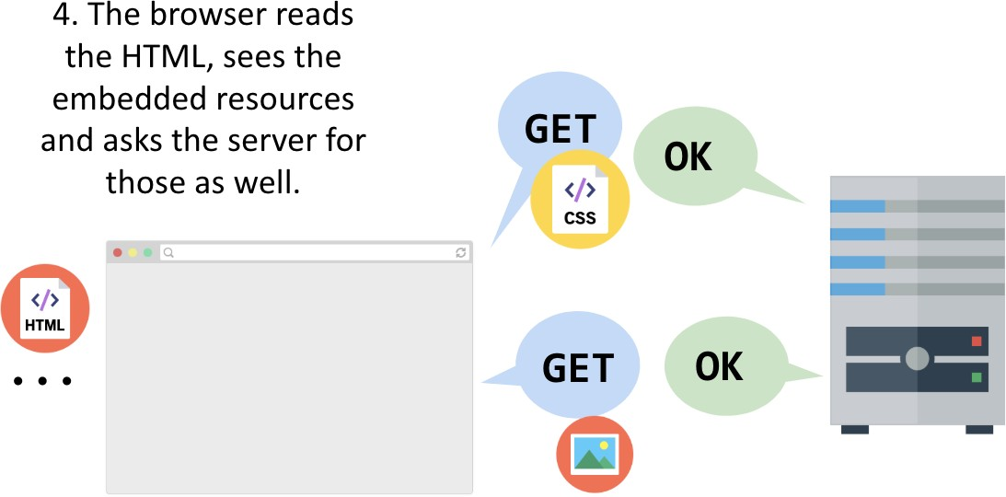
How do web pages work?

Slide 27


How do web pages work?
5. The web page is loaded when all the resources are fetched and displayed.
www.surrey.ac.uk

Slide 28

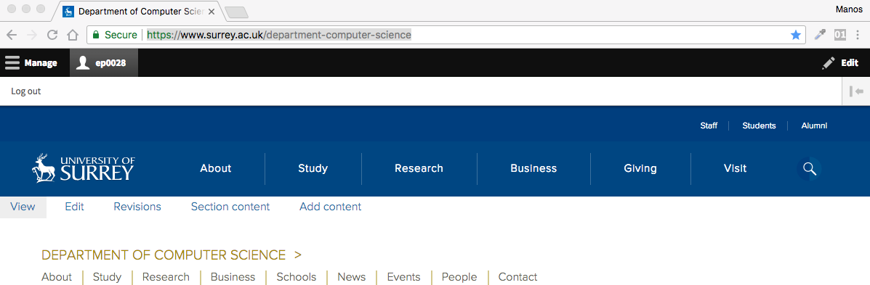
Request – response in more detail
Your PC is running a web browser

Slide 29
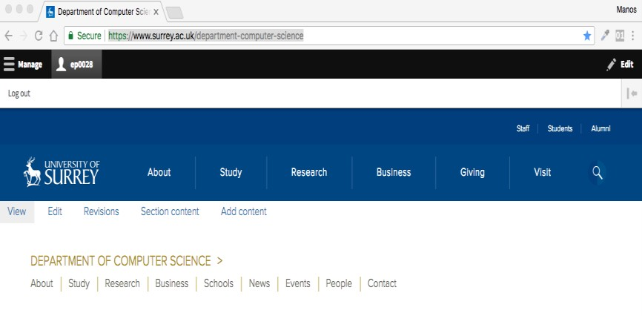
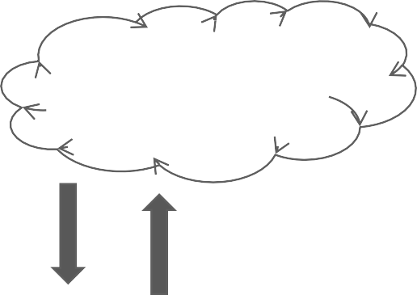


Web browser
Browser sends an HTTP request saying "Please GET
me the index.html file” at “https://www.surrey.ac.uk/”
Networking etc.
Assuming all goes well, the server responds by sending the HTML file through the internet back to the browser to display.
Server at https://www.surrey.ac.uk/

Slide 30
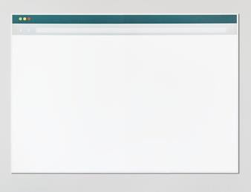
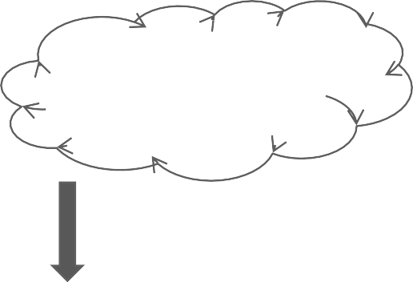
Web browser
The HTML will include things like <img src="pup.png" /> and <link src="style.css" .../> which generate more requests for those resources
Networking etc.
Server at https://www.surrey.ac.uk/
Web and Database Systems (COM1025)

Slide 31
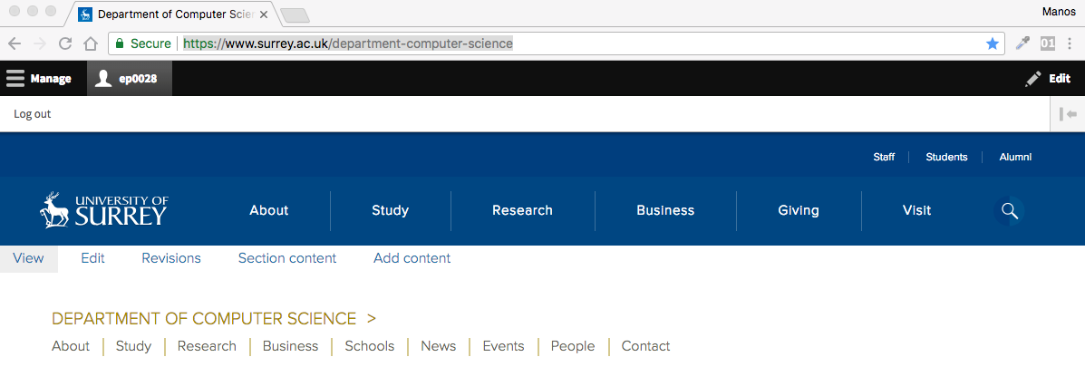
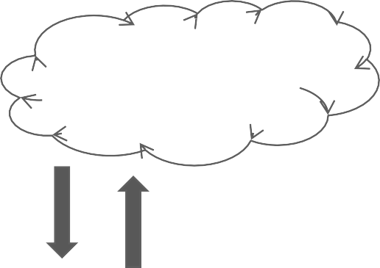
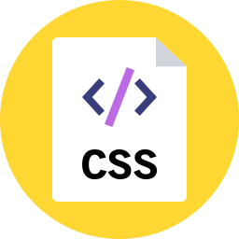

Web browser
Networking etc.
And the server replies with those resources for the browser to render
Server at https://www.surrey.ac.uk/
Web and Database Systems (COM1025)

Slide 32
Web browser
+
produces
Describes the content and structure of the page
Describes the appearance and style of the page
A web page… that doesn't do anything

Slide 33
URL

Slide 34
URI
A Uniform Resource Identifier (URI) is a string of characters used to identify a resource
The most common form of URI is the Uniform Resource Locator (URL), frequently referred to informally as a web address, e.g. https://developer.mozilla.org/en-US/
Web browsers request pages from web servers by using a URL
Some URIs refer to a location within a resource.
This kind of URI ends with "#" followed by an anchor identifier (called the fragment identifier) – see next.

Slide 35
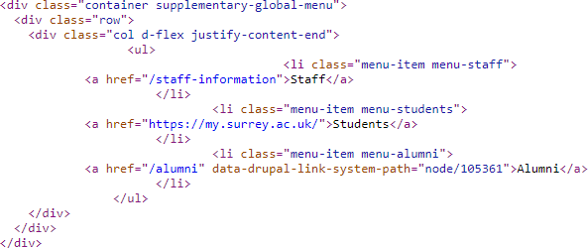
Absolute vs Relative
You can use both absolute and relative URLs.
Absolute URL: https://www.surrey.ac.uk
Relative URL: about is relative to https://www.surrey.ac.uk/about
Why does this matter?

Slide 36
URL syntax (as defined in RFC 3986)
Full syntax
scheme:[//[[userinfo@]host[:port]]] [path][?query][#fragment]
scheme (mandatory for absolute URLs)
The approach (communications protocol, “protocol” for short
hereinafter) for retrieving the document.
http: documents retrieved via a protocol called HTTP.
https: documents retrieved via a protocol called HTTPS.
file: documents accessible from the local machine.
ftp: documents retrieved via a protocol called FTP.
mailto: documents to be sent to the given email address (emails).
…
URLs are not only for the Web!

Slide 37
URL syntax (as defined in RFC 3986)
authority
Full syntax
scheme:[//[[userinfo@]host[:port]]] [path][?query][#fragment]
Two slashes (//): When the authority component is absent, the path component cannot begin with two slashes.
authority
A naming authority for parsing parts of the URL.
userinfo (optional)
An optional authentication section of a user name and password, separated by a colon, followed by @
The passing of authentication information in clear text has proven to be
a security risk in almost every case where it has been used.

Slide 38
URL syntax (as defined in RFC 3986)
authority
host (mandatory)
Domain name (or IP address) of the web site (server).
port (optional)
Port number used by the scheme (protocol).
In programming, it may specify a particular server program on a computer in a network

Slide 39
URL syntax (as defined in RFC 3986)
Full syntax
scheme:[//[[userinfo@]host[:port]]][path][?query][#fragment]
path
All the rest three components are optional.
Location of the document on the hosting machine (using “/” as the path separator).
query
also called a query string
A list of data sent to the web server, in the format
“name_1=value_1&…&name_n=value_n”.
Typical URL containing a query string is as follows:
http://example.com/over/there?name=ferret
When a server receives a request for such a page, it may run a program, passing the query string, which in this case is, name=ferret unchanged, to the program.
The first question mark is used as a separator, and it is not part of the query string.
fragment
ID of a fragment (section/part) of the document (”pointer to an HTML element”).
http://www.example.org/foo.html#bar the fragment refers to the element with id="bar".

Slide 40
HTML
Part I

Slide 41
HTML and CSS strategy
Assumption: Most people have cursory familiarity with HTML and CSS. Therefore we will:
Speed through the obvious stuff
Skip self-explanatory syntax
Skip the parts you can look up easily through Google

Slide 42
What is a markup language?
“A text-formatting language designed to transform raw text into structured documents”
Source: American National Standard Dictionary
of Information Technology (ANSDIT)
Source code (raw text)
<p style="color:red;">Red Text<p>
What you see in browsers (structured document)
Red Text

Slide 43
HTML and CSS
HTML
a markup language designed for web use
describes the structure and content of the page
descriptive markup
CSS
a generalised stylesheet language
specifies how the page should be rendered in various media (e.g. visual styles for screen display)
procedural (presentational) markup

Slide 44
HTML editor?
HTML documents (web pages) are human readable textual files.
⇒ You don’t need any special software to create/edit HTML
documents!
⇒ Any textual editor will do the job. [I use Atom]
However, you may find a textual editor with HTML syntax highlighting (e.g. Notepad++) very useful.
There do exist WYSIWYG (wiz-ee-wig) HTML editors (e.g. Adobe Dreamweaver), but to learn you better work directly with raw HTML code!

Slide 45
Web server or local files?
Web pages do not have to be tested on a remote web server.
To start learning HTML, you only need a (good) textual editor and a (good) web browser on your local machine!

Slide 46
HTML tags
HTML tags = Keywords surrounded by angle brackets, e.g. <html> and <p>
HTML tags normally come with pairs, e.g. <html>
… </html> and <p> … </p>.
In each pair of HTML tags, the first one (e.g. <html>) is called the start tag or opening tag, and the second one (e.g. </html>) is called the end tag or closing tag.
Inside the angle brackets, the ending tag starts with
a special character “/” (slash).

Slide 47
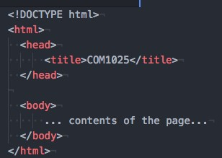


Basic HTML page structure
E.g.
<title> shows up as the name of the tab
Metadata that doesn't appear in the viewport of the browser
Contents that render in the viewport of the browser
Saved in a filename.html file

Slide 48
Encoding

Slide 49
Encodings (i.e. character sets)
Encoding is necessary so that computers understand the data we enter.
Characters must be encoded to a numerical (binary, decimal, hex) equivalent.
Every character is “given” (i.e., encoded to) an “x-bit number”,
called code point where x depends on the encoding we use:
e.g.: UTF-32: each character is stored in 4 bytes (=32 bits).
URL encoding converts characters into a format that can be
transmitted over the Internet.
Your browser will encode input, according to the character-set used in your page.
The default character-set in HTML5 is UTF-8 (most popular).

Slide 50
Why do they matter for web content?
Why do they matter for the Web?
You know it matters for URLs (addresses of web pages).
It matters for web content as well…
Web pages are textual documents.
A textual document = A sequence of characters encoded using a specific character encoding.
⇒ A character encoding is needed for creating the content of a web page and storing the web page as a file in the web server’s file system.
To display an HTML page correctly, a web browser must know the character set used in the page.

Slide 51
Declaring character encoding
The Character set meta tag is used to specify the encoding, of data that your
HTTP server sends.
To display an HTML page correctly, a web browser must know the character set used in the page.
This is specified in the <meta> tag:
HTML 4.01: <meta http-equiv="Content-type" content="text/html;charset=…">
HTML5: <meta charset=“UTF-8”>
Why do we need HTML codes?
The browser may get the encodings wrong.
One symbol might show up as another, or as an unknown character.
What is <meta>?
<meta> elements declare different kinds of metadata about an HTML document.
(We will come back to it later.)
Metadata will not be displayed on the page but will be machine parsable.
<meta> elements should be nested in the <head> element.

Slide 52

HTML (part II)

Slide 53
HTML vs CSS
HTML:
provides a structure that defines elements like tables, forms, lists and headings, and identifies where different portions of our content begin and end
can be used to embed other file formats like videos, audio files, documents like PDFs and spreadsheets, among others
CSS:
stands for cascading style sheet
used to create rules about the colour, font, and layout of our pages
also determines when those rules are to be used, based on information like the device connecting to the page, or in response to a user’s action

Slide 54
Page Layout
To add content to our page, we will set up our file with some basic structure
We use tags to identify information about where parts of our page start
and end
We will do this by using our first set of tags, <html> and </html>
An HTML element is everything from a start tag to the corresponding end tag: <title>This is the title.</title>
HTML elements are building blocks of HTML documents
Wrapping = placing a set of tags around content and other code
The content of an HTML element is everything between the start tag and the end tag.

Slide 55
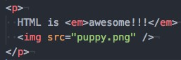
Page Layout
HTML elements can be nested:
<head><title>Title</title></head>
An element can be self-closing (img)
An element can have attributes (src="puppy.png")
Elements can contain other elements (e.g. p contains em and img)

Slide 56
Some HTML elements
(to place within <body>)
Top-level heading h1, h2, ... h6 | <h1>Headline</h1> which one is larger?
Paragraph | <p>The cat sat on the mat.</p>
Line break | First line <br/> Second line
Image | <img src="me.png" />
Link | <a href="google.com">click here!</a>
Strong (bold) | <strong>Be BOLD</strong>
Emphasis (italic) | My research field is <em>machine learning</em> and <em>computer vision</em>
Horizontal rule | My Bio: … <hr> My Publications

Slide 57
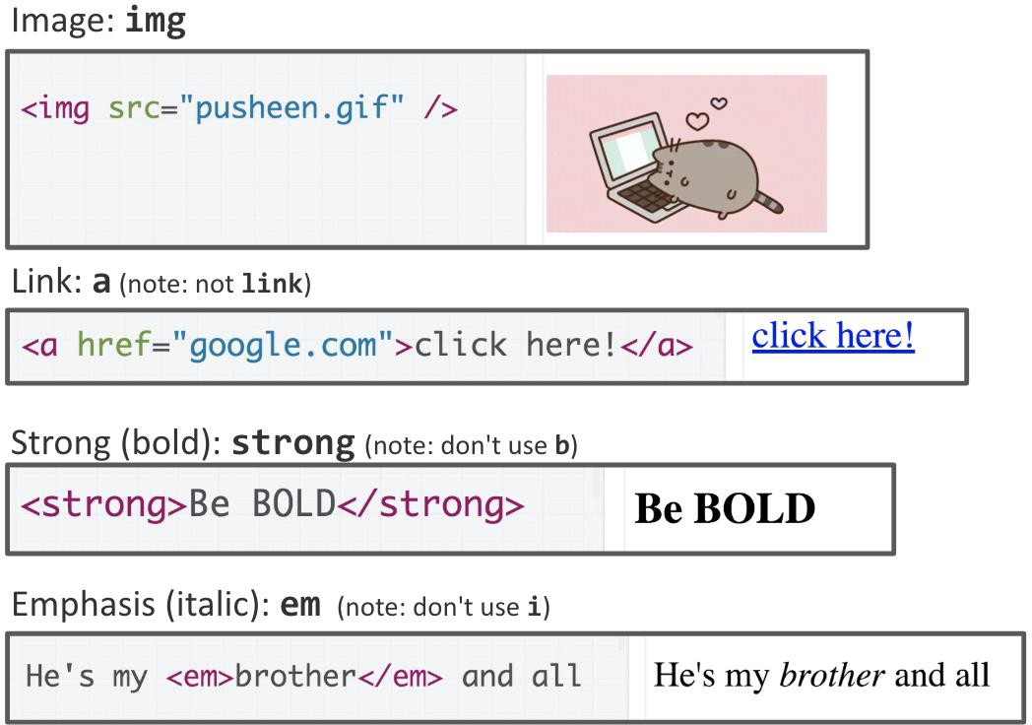
Some HTML elements

Slide 58


Slide 59
Types of HTML elements
Each HTML element is categorised by the HTML spec into:
block: large blocks of content, has height and width
<p>, <h1>, <blockquote>, <ol>, <ul>, <table>
Starting with a new line
Take up the full width of the page (flows top to bottom)
Have a height and width
Can have block or inline elements as children
inline: small amount of content
<a>, <em>, <strong>,<br>
Starting within the current line
Cannot have height and width
Cannot have a block element child
Cannot be positioned (i.e. CSS properties like float and position do not
apply to inline elements)
inline block: inline content with height and width <img>
metadata: information about the page, usually not visible
<title>, <meta>

Slide 60
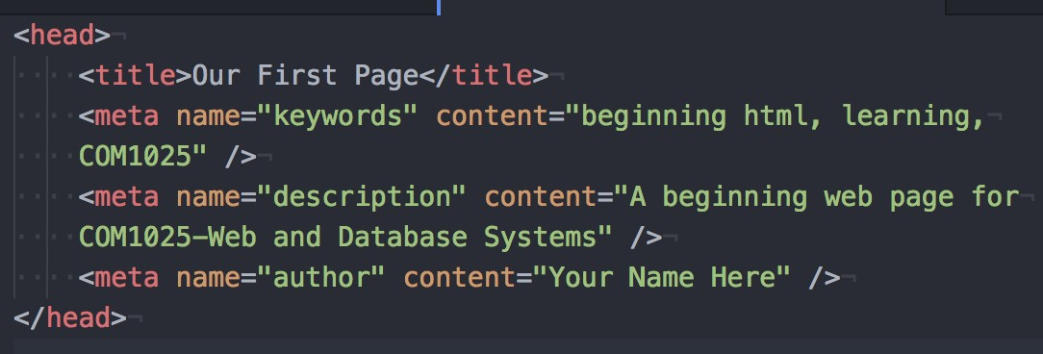
Head
This is where we:
put information about the page itself (called metadata)
connect to any other resources like scripts and files that are not part of the page we are using
It is important that your <head> tags are always the first set of tags after
<html>, as this is the order in which browsers expect the information
Add some meta tags inside our head to give it a title, keywords, a description, and other details
These pieces of information help the user and bots understand what the page
is about

Slide 61
HTML attributes
Most HTML elements have compulsory and/or optional attributes
Attributes provide additional information about an HTML element
Attributes are always specified in the start tag
How an attribute is specified (name + value):
name="value" or name='value'
name=value is also allowed if value does not contain space or any of any
of "'`=< >
the quotes identify what belongs to that attribute
Example
<html lang="en"> (lang defines language used)
<meta charset="UTF-8">

Slide 62
HTML facts
Comments in HTML
<!-- Comments are here. -->
The file extension of an HTML document can be either “htm” or “html”
No differences apart from the fact that some host servers expect
index.html than index.htm
HTML is case insensitive
In HTML code, more than one continuous spaces count as one space and line breaks are treated as spaces
More than one spaces (recall &nbsp;)

Slide 63
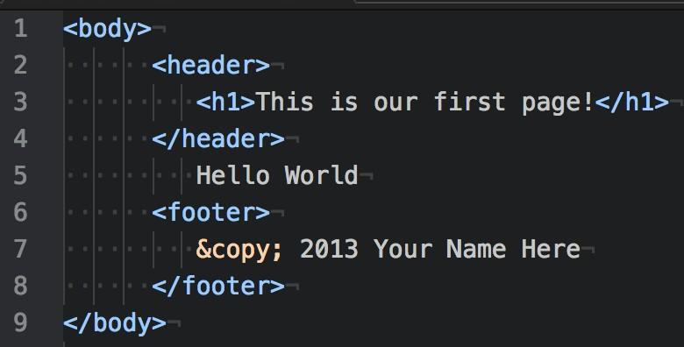
Header, Footer
The header and footer tags are new in HTML5.
They were added due to the volume of sites that define a top and bottom section to their pages.
Allowing these tags makes it easier to define and find those parts of the
layout.
The header and footer should be nested within your body tags
For our example, we will put a screen title in our header and a copyright
in our footer:

Slide 64
HTML tags: lists
ordered list
<ol>
<li>Item 1</li>
<li>Item 2</li>
...
</ol>
li = list item
https://www.w3schools.com/tags/tag_ol.asp

Slide 65
HTML tags: lists
unordered list
<ul>
<li>Item 1</li>
<li>Item 2</li>
...
</ul>
https://www.w3schools.com/tags/tag_ol.asp

Slide 66
HTML tags: lists
description list
<dl>
<dt>item1</dt>
<dd>dscrp1</dd>
<dt>item2</dt>
<dd>dscrp2</dd>
</dl>
https://www.w3schools.com/tags/tag_dl.asp

Slide 67
Tables
Tables are a method of formatting the content of your page, and are very similar to the concept of a spreadsheet
To create a table, we first need to define its beginning and end with tags:
<table></table>
Adding row <tr>, Add table heading <th>
https://www.w3schools.com/tags/tag_table.asp

Slide 69
HTML tag: <iframe>
Basic syntax
<iframe src="..." ...>text for web browser without iframe support</iframe>
This HTML tag allows display of another HTML document in an inline
(embedded) frame.
Some commonly used attributes
src: URL of the embedded HTML document
name: name of the iframe (which can be the value of target attribute of
an <a> element)
width, height: width and height
frameborder: size of the iframe border
https://www.w3schools.com/tags/tag_iframe.asp

Slide 70
End of Week 1

Slide 71
COM1025: Web and
Database Systems
Computer Networking, HTML, CSS
(Slides credited to Dr. Manos Panaousis)
Week 8

Slide 72
Computer Networking

Slide 73
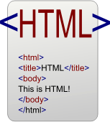

From the Internet to the Web
Computers (PCs, servers,
laptops, smart phones, tablets, …)
Computer networks
A particular
interconnected network of computer networks
= Internet
“particular” =
A special set of networking protocols (TCP/IP)

Slide 74







How does the Internet work?
Each network interface of a networked computer on the Internet (host) has a unique address (~street number).
One computer may have n>1 network interfaces so n>1 addresses (e.g. a PC has both LAN and WiFi connections).
Data from one host (source) to another (destination) is divided
into packets (~letters/parcels).
1 2
Those packets are sent separately from the source to the destination via a number of routers (~post offices).
1
2

Slide 75
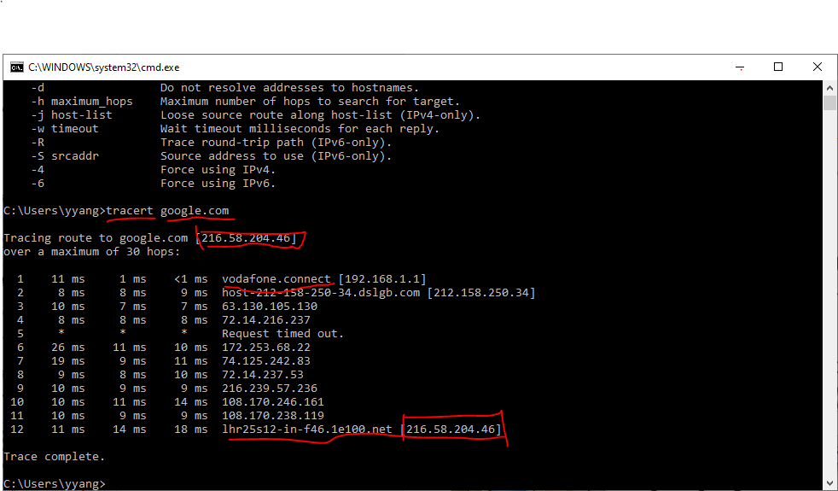
Traceroute

Slide 76
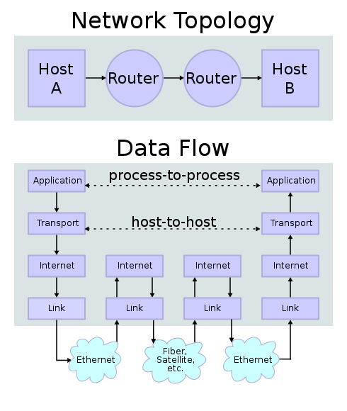
Four abstract layers of the Internet
Application layer: HTTP(S), FTP, SMTP, DNS, …
Transport layer: TCP, UDP
Internet layer: IP
Link layer: the
Web
underlying networking architecture below IP (Ethernet, 802.11)

Slide 77
UDP vs TCP
UDP:
Anything where you don't care too much if you get all data
always
Tunnelling/VPN (lost packets are ok - the tunnelled protocol takes care of it)
Media streaming (lost frames are ok)
Online games that don't care if you get every update
Local broadcast mechanisms (same application running on different machines "discovering" each other)
(Speed)
TCP:
Almost anything where you have to get all transmitted data
Web
SSH, FTP, telnet
SMTP, sending mail
IMAP/POP, receiving mail
(Reliability)

Slide 78
Four abstract layers of the Internet
Application layer: HTTP(S), FTP, SMTP, DNS, …
Transport layer: TCP, UDP
Internet layer: IP
Link layer: the
Web
underlying networking architecture below IP (Ethernet, 802.11)

Slide 79
IP and IP addresses
The communications protocol sending data packets from one host to the other via routing is called the Internet Protocol (IP).
Two editions: IPv4 and IPv6.
The unique address of each host is called its IP address.
IPv4: 32-bit, normally written as 4-segment dot-decimal format a.b.c.d, where each segment is an 8-bit integer between 0 and 255: e.g. 172.16.254.1.
IPv6: 128-bit, new-generation IP address, but wide development is still to come,
https://www.google.com/intl/en/ipv6/statistics.html#tab=per- country-ipv6-adoption

Slide 80
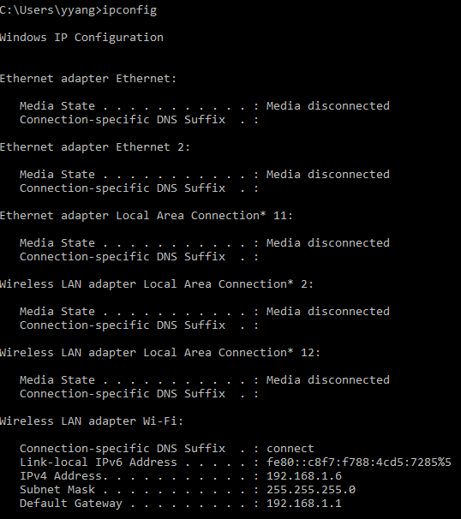
Check your own IP

Slide 81
From IP addresses to domain names
IP addresses are difficult to remember!
How can one remember meaningless IP addresses?
And many different IP addresses?
And much longer 128-bit IPv6 addresses?

Slide 82
From IP addresses to domain names
IP addresses are difficult to remember!
How can one remember meaningless IP addresses?
And many different IP addresses?
And much longer 128-bit IPv6 addresses?
More user-friendly domain names are introduced as aliases of IP addresses.
DNS (domain name system) servers convert domain names to IP
addresses.
Multiple domain names may point to the same IP address.
Syntax: hostname.sub_domain.….top_level_domain
Example 1: surreylearn.surrey.ac.uk ⇒ 131.227.132.44

Slide 83
From IP addresses to domain names
IP addresses are difficult to remember!
How can one remember meaningless IP addresses?
And many different IP addresses?
And much longer 128-bit IPv6 addresses?
More user-friendly domain names are introduced as aliases of IP
addresses.
DNS (domain name system) servers convert domain names to IP addresses.
Multiple domain names may point to the same IP address.
Syntax: hostname.sub_domain.….top_level_domain
Example 1: surreylearn.surrey.ac.uk ⇒ 131.227.132.44
Example 2: localhost ⇒ 127.x.x.x (on many systems just 127.0.0.1) = the
current machine itself (Local debug)

Slide 84
CSS

Slide 85
CSS = Cascading Style Sheet
CSS is a language that describes the presentation of a document written in a markup language
Describes the appearance and layout of a web page
Composed of CSS rules, which define sets of styles
CSS saves a lot of work
It can control the layout of multiple web pages all at once.

Slide 86
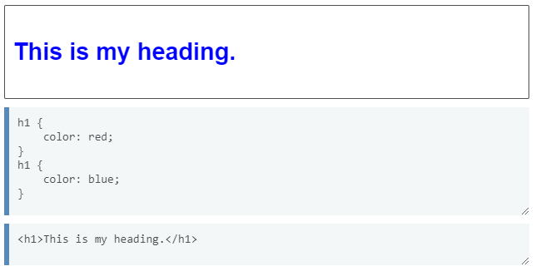
CSS = Cascading Style Sheet
What does “cascading” mean?
Each HTML element can be styled by a number of style sheets one cascading on top of another.
This means order matters (we will go back here soon)

Slide 87
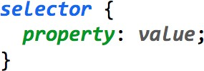
CSS
A CSS file is composed of style rules:
selector: Specifies the HTML element(s) to style.
A selector can refer to an existing tag that is part of the HTML structure like unordered lists, paragraphs, inputs, or it can refer to a custom class, element’s name, or ID that we create.
rules we enter in between the braces apply to the selector we specify.
property: The name of the CSS style.
value: The value for the CSS style.
Note that in CSS, we use the colon (:) instead of an equal sign (=) to assign values.
Saved in a filename.css file.

Slide 88
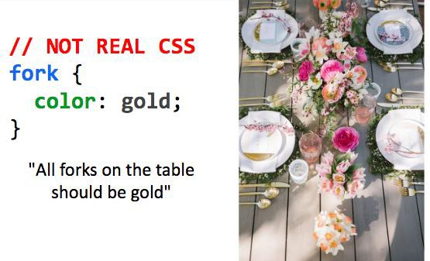
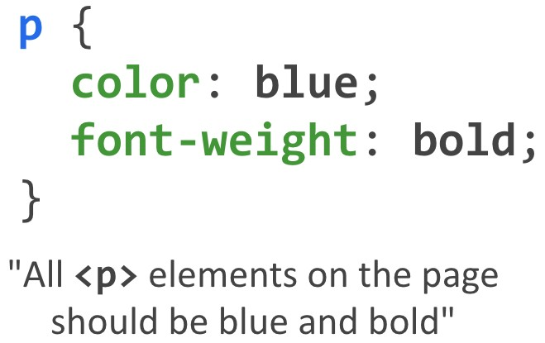
CSS

Slide 89

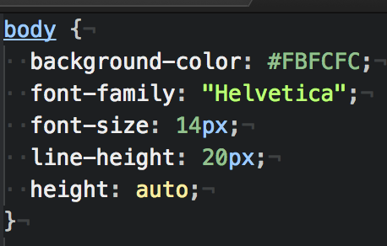
Examples

Slide 90
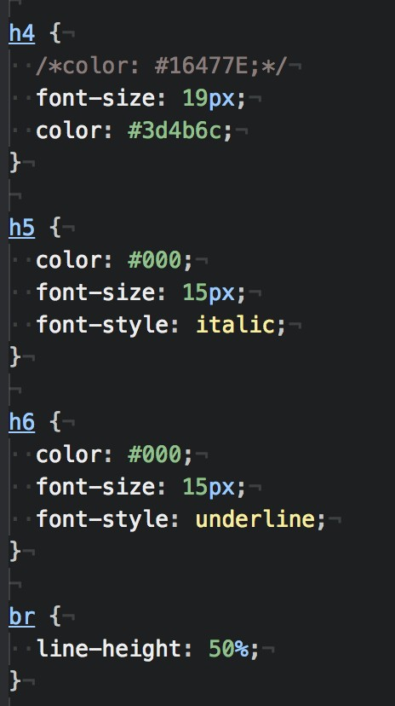
Examples

Slide 91
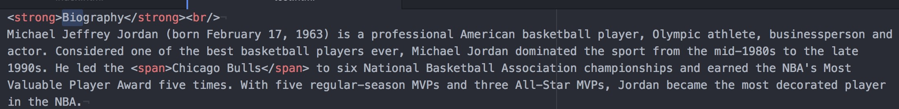
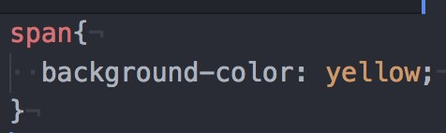
<div> and <span>
Two generic tags with no intended purpose or style:
<div>: a generic block element
<span>: a generic inline element
In contrast, some tags, e.g., <strong>, has built-in styles (defined in your web browsers)
HTML
CSS
But won't we often want multiple generic containers?
How do we distinguish two generic containers?
In other words, how do we select a subset of elements instead of all elements on the page?

Slide 92
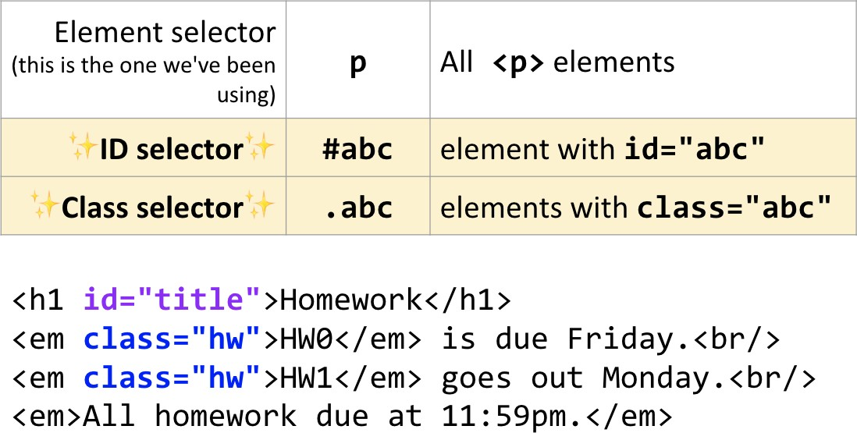
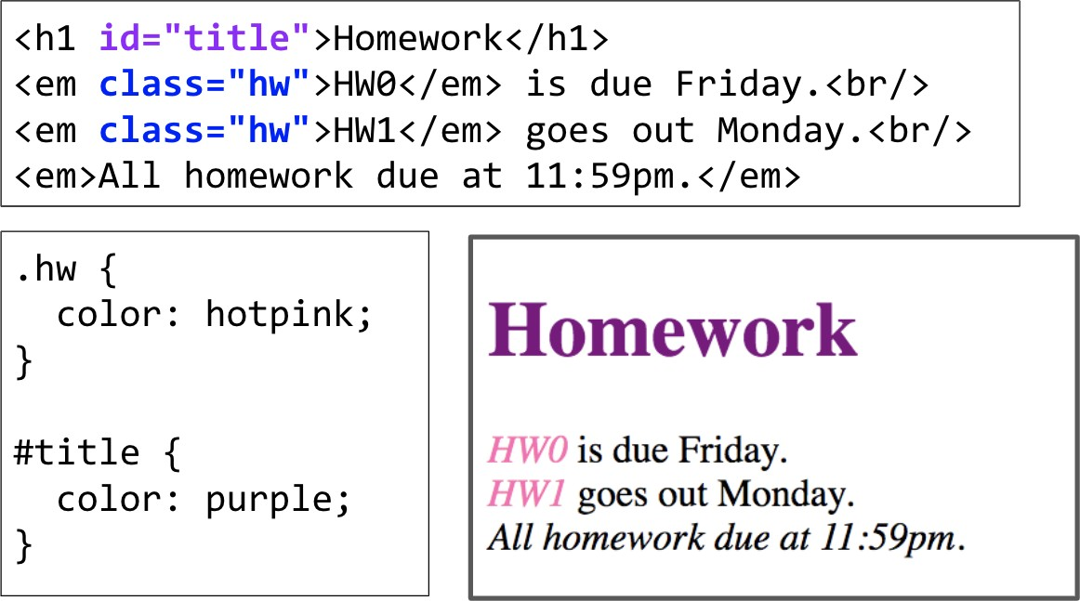
CSS Selectors: Classes and Ids
Often used with span and div to create generic elements: e.g. <span class="highlight"> is like creating a "highlight" element

Slide 93
Classes
We attach classes to our tags to apply different styles to the same selector type
adding the ability to be more specific about which occurrence we are talking about
We use classes by giving them rules in CSS
We refer to classes as attributes in elements that support them
from our HTML document by using class=“nameOfOurClass.”
When defining classes in our CSS file, we precede their name with a period to specify they are a class

Slide 94
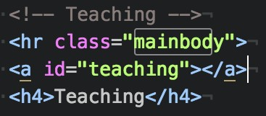
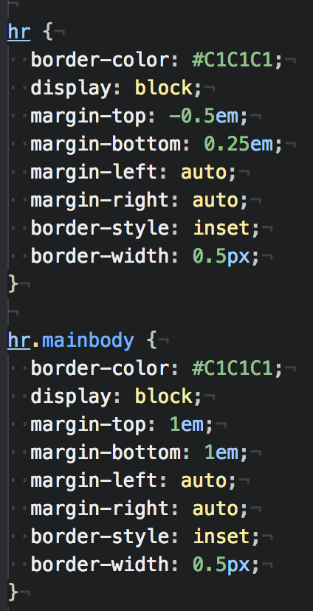
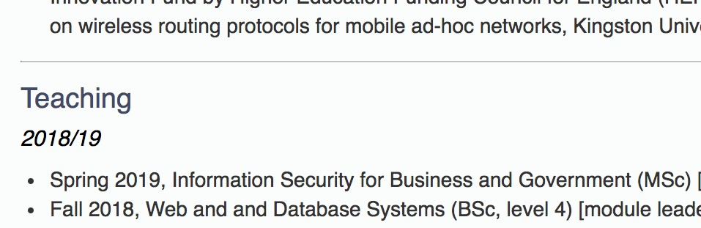
Examples

Slide 95
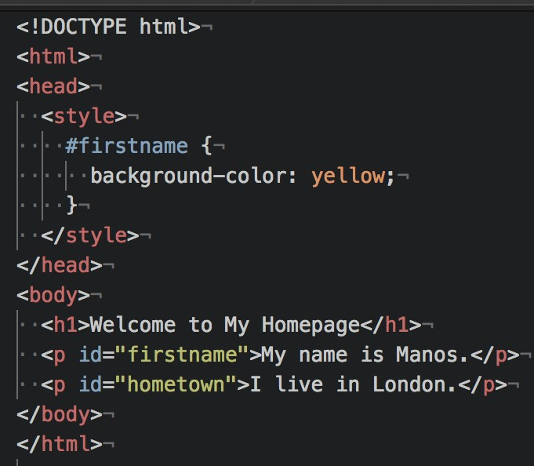
IDs
The ID attribute is used similar to how a class is used, with two differences:
The ID is defined with a # instead of a period
You should use an ID only once on a page, as it should identify something unique to the document.

Slide 96
Some CSS properties
There are over 500 CSS properties! Here are a few:
Font face (mdn) | font-family: Arial;
Font color (mdn) | color: gray;
Background color (mdn) | background-color: orange;
Border (mdn) | border: 5px solid orange;
Text alignment (mdn) | text-align: left;
Mozilla Developer Network (MDN) is one of the best reference for HTML elements
and CSS properties
The actual W3 spec is more hard to read (meant for browser developers, not web developers)

Slide 97
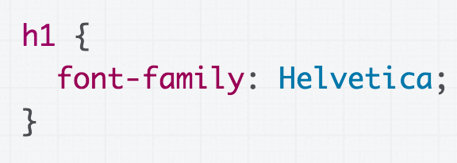
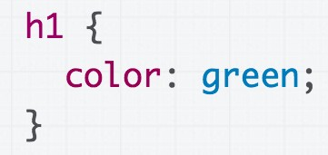
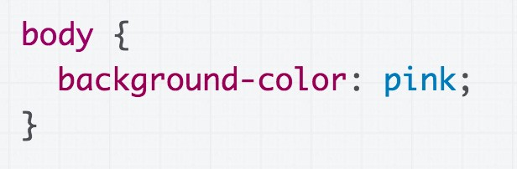
Some CSS properties
Font face: font-family
Some Texts
Font color: color
Some Texts
Some Texts
Assign a background-colour to body
to make the page a different colour.

Slide 98
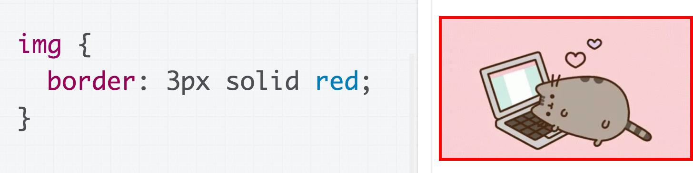
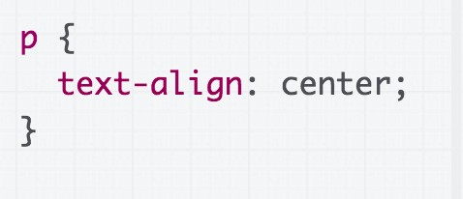
Some CSS properties
Border: border (border shorthand syntax)
Text alignment: text-align (note: don't use <center>)
Welcome to my personal webpage. You can find here more information about my recent publications and projects.

Slide 99
How to add CSS to HTML
CSS can be added to HTML elements in 3 ways:
Inline - by using the style attribute in HTML elements
Internal - by using a <style> element in the <head> section of the html file.
External - by using an external CSS file

Slide 100
Inline CSS
Styles defined using the style attribute inside the HTML elements are called inline styles
Syntax
style="property_1:value_1; …; property_n:value_n;”
E.g. <h1 style="color:blue;margin-left:30px;">This is a heading</h1>
Basically it is a list of CSS properties which define the style of the current HTML element.
The value of a property may take several sub-values
separated by space, e.g. “border: 5px solid black”

Slide 101
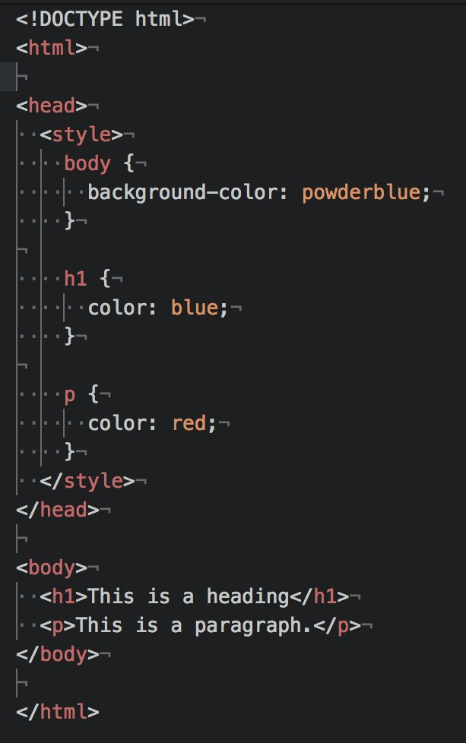
Internal CSS
An internal CSS is used to define a style for a single HTML page.
It is defined in the <head> section of an HTML page, within a <style> element:

Slide 102
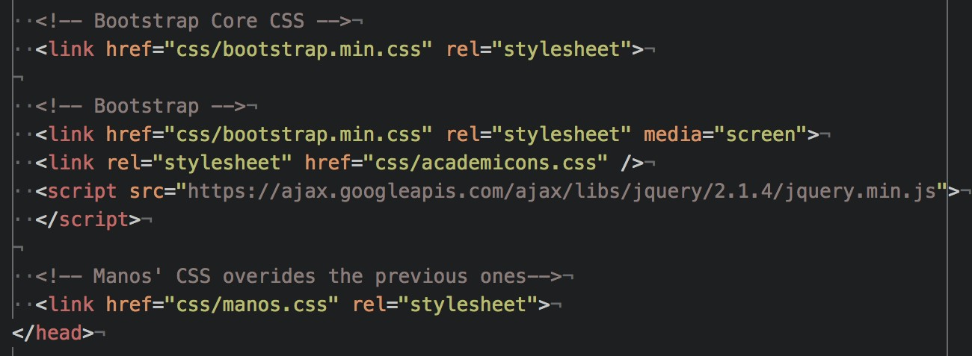
External CSS
An external style sheet is used to define the style for many HTML pages
With an external style sheet, you can change the look of an entire web site, by changing one file!
To use an external style sheet, add a link to it in the <head>
the HTML page
Multiple <link> elements are allowed
section of

Slide 103
Precedence of CSS styles
Inline styles (highest precedence)
Internal and external style sheet(s)
When there are multiple <link> and <style> elements in the <head> element, the style sheet appearing later takes precedence
Browser default styles (lowest precedence)

Slide 104
HTML forms

Slide 105

Example

Slide 106
Forms
An HTML form is a collection of HTML elements embedded within a page.
Purpose
Used for web server to collect data from users (client), which is submitted to a server-side program/script for generating dynamic web pages
By adding different types of elements, you can create different form fields, such as text fields, pull-down menus, checkboxes, and so on.
All Web forms start with an opening <form> tag, and end with a closing </form> tag

Slide 107

Forms’ attributes
Two attributes within the opening <form> tag:
The action attribute defines where the data will be sent to:
It is normally a URL pointing to a server-side program/script, but it can also be a mailto URL
This should either be an absolute URL or a relative URL
The method attribute tells the browser how to send the form data:
GET is for sending small amounts of data and makes it easy for the user to resubmit the form
POST can send much larger amounts of form data

Slide 108
<input>
<input> elements are used within a <form> element to declare input
controls that allow users to input data
Attributes (e.g.):
Type: specifies the type <input> element to display, e.g. text, button, checkbox, etc.
Name: specifies the name of an <input> element
Q: How is “name” attribute used?
A: it can be used on the client side by JavaScript and the server script uses it to retrieve its value as entered by the user in that input field.

Slide 109


Example

Slide 110

Form: <input> controls
<input type="…" …>: various input controls
type="checkbox": check box
type="radio": radio button
type="text": one-line text box (default type)
type="password": password input box
type="file" (*): an input field with a
“Browse…” button for localizing a local file
type="button": a clickable button
type="submit": a submission button
type="image": an image as the submission button
type="reset": a reset button (for clearing all fields)
type="hidden" (*): a hidden input field

Slide 111
Forms: two data submission methods
method="get" (the default method)
The form data is URL encoded and appended to the URL of the receiver (i.e. value of the action attribute) as a query string
…/process_form.php?name=Manos+Panaousis&mail=e.Panaousis@s urrey.ac.uk
Data size is limited to the maximum size of a URL (depends on user agent)
The URL (with the data) can be bookmarked and re-submitted without filling the form again
Form data is visible in the address bar, so not for password!
method="post"
The form data is sent to the server as the message body of an HTTP request, not part of the URL
Not limited to the maximum size of a URL
Form data is invisible in the address bar, so sensitive information is less exposed (but not necessarily secure – which requires HTTPS)

Slide 112


Forms: a simple example
After clicking “Send” button, your will see the following URL in the address bar of your web browser:
…/process_form.php?name=Shujun+Li&mail=hooklee%40gmail.com

Slide 113


<select>

Slide 114
How to handle submitted data
When the data is submitted via HTTP GET method (e.g. <form …
method="get">)
The data is accessible as an array $_GET
In a web form: <input type="text" name="username">
I entered “manos” and submitted the data
Address bar of web browser (URL): http://.../...?...username=manos...
Server side: $_GET['username'] retrieves the submitted data
“manos” associated with the name (key) “username”
When the data is submitted via HTTP POST method (e.g. <form
… method="post">)
The data is accessible as an array $_POST
Everything else is the same as above

Slide 115
HTTP

Slide 116
HTTP
The Hypertext Transfer Protocol (HTTP) is designed to enable communications between clients and servers.
HTTP is a two-party communication protocol:
Party 1 – The client @ Computer 1: A web browser (also called a “user
agent”) that requests web pages
Party 2 – The server @ Computer 2: A program that handles requests of web pages from multiple clients
Steps:
A client submits an HTTP request to the server.
The server returns an HTTP response to the client.
The response contains status information about the request
and may also contain the requested content.
HTTP uses the Transmission Control Protocol (TCP)

Slide 117


Web browser vs. Web (HTTP) server
The program running at the server side is normally called a web
server or an HTTP server
Two most widely used web (HTTP) servers
Apache HTTP Server: cross-platform, used in our labs and for your
coursework (We will use this one)
Microsoft IIS (Internet Information Services, formerly known as Internet Information Server): Windows platforms only
Security?
It has a secure edition HTTPS (HTTP Secure)
HTTPS allows both end-to-end encryption of all communications between the web server and the web browser, and also server/client authentication
Its uses a cryptographic protocol called TLS/SSL

Slide 118





From static to dynamic web pages
Server-side
Program/Script
A requested web page is not necessarily a static one
It can be a server-side program/script residing on the web server
Why do we need dynamic programs/scripts?
HTTP(S)
TCP IP
URL
Handle dynamic data.
Interact with users.
Do more with less code!
…

Slide 119
Request a dynamic web page
User ⇒ Web browser
URL http://... (optionally + data)
Web browser ⇒ Web server
URL http://... (optionally + data)
Web server:
Server-side
Program/Script
URL ⇒ Local file path
Execute the local file as a program and
record the output (HTML code)
HTTP(S)
TCP IP
URL
+data
Web server ⇒ Web browser
HTML code generated above
Web browser ⇒ User
The received HTML code shown (in a web browser) as a web page

Slide 120

Sending a client request
Once the connection is established, the user-agent (e.g. web browser, a crawler) can send the request
A client request consists of text directives divided into:
The first line contains a request method (GET, POST) followed by its
parameters:
the path of the document, i.e. an absolute URL without the protocol or domain name
the HTTP protocol version

Slide 121
Sending a client request
Subsequent lines represent an HTTP header, giving the server information about what type of data is appropriate (e.g. what language), or other data altering its behavior (e.g. not sending an answer if it is already cached).
Then, the Request Message itself is included

Slide 122

Example of a request

Slide 123

Structure of a server response
The web server processes the request, and ultimately returns a response
A server response is formed of text directives, divided into the following blocks:
The first line, the status line, consists of an acknowledgment of the
HTTP version used, followed by a status request (and its brief meaning in
human-readable text).
Subsequent lines represent specific HTTP headers, giving the client information about the data sent (e.g. type, data size, compression algorithm used, hints about caching).

Slide 124
Structure of a server response
A server response is formed of text directives, divided into the following blocks:
Similarly to the block of HTTP headers for a client request, these HTTP
headers form a block ending with an empty line.
The final block is a data block, which contains the optional data.

Slide 125
Beyond URL: data transmission
Client (web browser) ⇒ Web server
An HTTP request contains: URL (what web page?), data (what data is sent to the requested web page?)
Two main ways (called HTTP request methods or verbs in HTTP
terms) for transmitting data from client to server:
GET
Requests data from a specified resource.
Data transmitted as part (query string) of the URL: http://.../...?data1=value1&data2=value2...#fragment_ID
POST
Submits data to be processed to a specified resource.
Data transmitted as the message body of an HTTP request.

Slide 126
The GET method
the query string (name/value pairs) is sent in the URL of a GET request:
e.g., /test/demo_form.php?name1=value1&name2=value2
GET method sends the encoded user information appended to the page request
The page and the encoded information are separated by the ? Character
The GET method produces a long string that appears in your server logs
GET requests should be used only to retrieve data
GET requests should never be used when dealing with sensitive data
Note: GET can't be used to send binary data, like images or word
documents, to the server (string exclusively)
To be covered: PHP provides $_GET associative array to access all the
sent information using GET method
GET requests remain in the browser history and they can be bookmarked

Slide 127

The POST method
the query string (name/value pairs) is sent in the HTTP message body of a POST
request:
It has no limit on data size (unlike GET method that is capped by max-length of URL)
The POST method transfers information via HTTP so its security depends on
HTTP protocol:
By using Secure HTTP you can make sure that your information is secure
To be covered: PHP provides $_POST associative array to access all the sent information using the POST method
POST requests do not remain in the browser history and they cannot be
bookmarked

Slide 128


File extension matters!
How can the web server know if a requested file should be treated as a server-side program/script?
File extension matters!
When the extension is “htm” or “html” the
PHP
module
web server knows what the client requests is a static web page
When the extension is a different one (e.g. “php” or “asp”), the web server knows a server-side program/script needs invoking
HTTP Server

Slide 129
The Web/HTTP is stateless
HTTP protocol itself is stateless (memoryless)
So is the Web!
Each HTTP request is processed without knowledge of any prior requests
A stateless protocol does not require the server to retain information or status about each user for the duration of multiple requests
No need to dynamically allocate storage to deal with conversations in
progress
It minimises time/bandwidth that would otherwise be spent reestablishing a connection for each request
If a client session dies in mid-transaction, no part of the system needs to be responsible for cleaning up the present state of the server

Slide 130



The Web/HTTP is stateless
In many applications, we want the web server to have memory
of the client’s visiting history
E.g., For a registered user of a website, he/she should be able to log in once for the whole website
So we need some mechanism to make the Web (HTTP) stateful
(= memoryful).
Save information about historical visits to the web server
So the web server keeps a memory of the past
What information do we need to save?
Data submitted via HTML forms
Data submitted via URLs (query strings, may not be via a form)
Who visited what, when and from where and how?
Maximally, everything about the visit history of every visitor!

Slide 131
Making Web/HTTP stateful
Q: How do we save such information?
A: Multiple ways
As web (HTTP) cookies (client-side data, short- and long-term)
As session variables (server-side data, short-term)
In databases (server-side, long-term)
In data files (server-side data, long-term)
We will cover everything!

Slide 132


Sessions
A (client-side) Web/HTTP session lasts from the first time the user visits a web server until the web browser closes
Q: How is the session ID maintained during a Web
session?
ID =
2fp8nq22d6vh2q a788nngm2644
Name=Manos Login=True Index=100
…
Stored as a (client-side) session cookie
Communicated as a URL parameter as part of the
query string of each URL
Note: Each client-side session has a unique ID and can be associated with a number of session variables stored at the server side

Slide 133


A typical HTTP session (3 phases)
The client establishes a TCP connection:
The client must know the IP address and the port number of the desired server
The client sends its request to the server, and waits for the answer
The server processes the request, sending back its answer, providing a status code and returned data

Slide 134
Response status codes
HTTP response status codes indicate if a specific HTTP request has been successfully completed
Responses are grouped into five classes:
Information responses:
e.g. 100 Continue: Indicates that everything so far is OK and that the client should continue with the request or ignore it if it is already finished:
To have a server check the request's headers, a client must
send Expect: 100-continue as a header in its initial request and receive a 100 Continue status code in response before sending the body
Successful responses:
e.g. 200 OK: The request has succeeded

Slide 135

Response status codes
Redirection messages:
e.g. 301 Moved Permanently: indicates that the resource requested has been definitively moved to the URL given by the Location headers
Client error responses:
e.g. 404 Not Found: the server can not find requested resource
This response code is probably the most famous one due to its frequent
occurrence on the web
e.g. 403 Forbidden: indicates that the server understood the request but refuses to authorise it

Slide 136
Response status codes
Server error responses:
e.g. 500 Internal Server Error
Wrong implementation of server side script

Slide 137
Cookies

Slide 138



HTTP Cookies
An HTTP cookie is a small piece of text file that is downloaded onto ‘terminal equipment’ after sent by the server to the user's web browser when the user accesses a website:
It remembers stateful information for the stateless HTTP protocol
It allows the website to recognise the user’s device and store some information about the user’s preferences or past actions
When receiving an HTTP request, a server can
send a Set-Cookie header with the HTTP response
Set-Cookie: <cookie- name>=<cookie-value>

Slide 139




HTTP cookies
Cookies can be used for a variety of reasons:
PERSONALISATION - remember your preferences on a site:
e.g. whether you read the oldest or newest comments first; the volume on the video player.
TRACKING - understand how you are using the site:
e.g. to tell what the most popular news story of the day is; to record how you responded to a new design or version of the site.
SESSION MANAGEMENT - for logging in to a service or to make sure you're logged in securely:
these cookies may contain information such as your email address and your name – the information you gave when you signed up
the website you signed up to is the only site that can access this information
Cookies are sent with every request, so they can worsen
performance (especially for mobile data connections)

Slide 140

Creating cookies
Cookie is composed by server-side program/script (e.g., PHP) and sent to
the client via “Set-Cookie” in HTTP response
The cookie can be stored by the browser, and then the cookie is sent with requests made to the same server inside a Cookie HTTP header

Slide 141

HTTP cookies

Slide 142

Session and Permanent cookies
The cookie created above is a session cookie
it is deleted when the client shuts down, because it didn't specify an Expires or Max-Age directive.
However, web browsers may use session restoring, which makes most session cookies permanent, as if the browser was never closed.
Instead of expiring when the client closes, permanent
cookies expire at a specific date (Expires) or after a specific length of time (Max-Age).

Slide 143

HTTP cookies
Cookies are stored for a particular domain:
They can be made accessible to a single domain name (e.g. www.foo.com) or all its subdomain names (e.g. *.foo.com).
Cookies have an expiration time:
Default: expire once the web browser closes = session cookies
Secure Cookies (*): Cookies made valid for HTTPS only
A secure cookie will only be sent to the server when a request
is made using SSL and the HTTPS protocol
However, confidential or sensitive information should never be stored or transmitted in HTTP Cookies as the entire mechanism is inherently insecure and this doesn't mean that any information is encrypted

Slide 144

HttpOnly cookies
HttpOnly Cookies (*):
Cookies available to server only
HttpOnly is an additional flag included in a Set-Cookie HTTP response header
Using the HttpOnly flag when generating a cookie helps mitigate the risk of client side script accessing the protected cookie.
To prevent cross-site scripting (XSS) attacks, HttpOnly cookies are inaccessible to JavaScript's Document.cookie API

Slide 145






Cookies in different web browsers
Google Chrome
– “Settings” – “+ Show advanced settings” - “Privacy” section – “Content settings…” button – “Cookies” section (“All cookies and site data…” button for viewing cookies)
Mozilla Firefox
– – – “History” section – “remove individual cookies” link (cookie viewer) / “Firefox will” drop-down list “Use custom settings for
history” (cookie settings)
Microsoft Internet Explorer (MSIE)
Viewer: – “Internet Options” menu item – “General” tab – “Browsing history” section – “Settings” button – “View files” button – search files using “cookie” as keyword
Settings: – “Internet Options” menu item – “Privacy” tab – “Advanced”
button – “Override automatic cookie handling” checkbox

Slide 146


Privacy?
Contrary to a common belief, cookies do not contain software programs, so cannot install anything on a computer
Cookies generally do not contain any information that would identify a person (Personal Identifiable Information - PII)
Usually they contain a string of text or "unique identifier”
acting like a label
When a website sees the string of text it set in a cookie, it knows the browser is one it has seen before
However, cookies may violate the user’s privacy as it gives the remote server access to local data
Cookies can be disabled in the web browser by the user

Slide 147
The GDPR, Cookie Consent
The EU General Data Protection Regulation (GDPR) has now been in force
The GDPR is an over-arching piece of legislation dealing with all aspects
of the processing of personal information
Cookies are mentioned once in the GDPR, in Recital 30:
“Natural persons may be associated with online identifiers…such as internet protocol addresses, cookie identifiers or other identifiers…. This may leave traces which, in particular when combined with unique identifiers and other information received by the servers, may be used to create profiles of the natural persons and identify them.”

Slide 148
End of Week 7

